Slide 1
Introduction to Operating Systems Lab-01
Dr. Ahmed Awais

Slide 2
How to install Linux on Windows with WSL
Install WSL | Microsoft Learn
https://learn.microsoft.com/en-us/windows/wsl/install

Slide 3
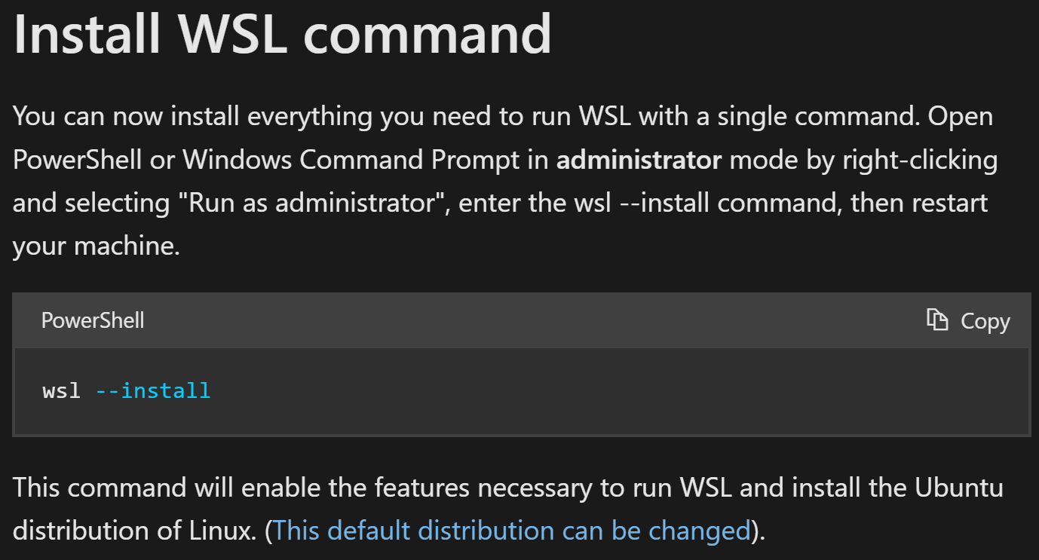
How to install Linux on Windows with WSL

Slide 4
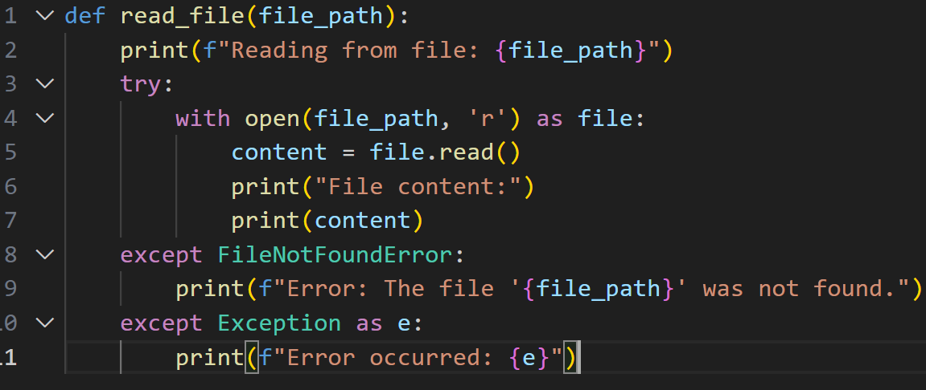
Read a file
Experience read, readline and readlines

Slide 5
Importing OS Module in Python
The os module in Python provides a way to interact with the operating system. It includes functions to handle file operations, directory management, and other OS-related tasks.
Let’s write a simple program to demonstrate process creation.
import os
def create_process():
print("Current Process ID:", os.getpid())
print("Parent Process ID:", os.getppid())
create_process()

Slide 6
Python psutil
psutil is a cross-platform library in Python used for retrieving information on running processes and system utilization, such as CPU, memory, disks, network, and sensors.
It is mainly used for system monitoring, profiling, and managing running processes.
psutil supports various platforms including Linux, Windows, macOS, FreeBSD, OpenBSD, NetBSD, Sun Solaris, and AIX

Slide 7
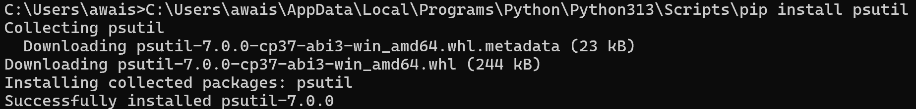
Program: Write a program that lists all running processes using the psutil library.
import psutil
def list_processes():
for proc in psutil.process_iter(['pid', 'name']):
print(proc.info)
list_processes()

Slide 8
2. Download get-pip.py
Download the get-pip.py script from the official source:
curl https://bootstrap.pypa.io/get-pip.py -o get-pip.py
3. Install pip
Run the downloaded script using Python:
python get-pip.py
This will install pip on your system.
4. Verify pip Installation
To verify that pip has been installed correctly, type:
pip --version
This should display the version of pip installed.
Installing pip on Windows
To install pip on Windows, you need to follow a few simple steps. Pip is a package manager for Python that allows you to install and manage additional libraries and dependencies.
Step-by-Step Guide
1. Verify Python Installation
First, ensure that Python is installed on your system. Open Command Prompt and type:
python --version
If Python is installed, it will display the version number.

Slide 9
5. Add pip to Environment Variables (if needed)
If you encounter a "pip not recognized" error, add pip to your PATH environment variable:
Locate the pip installation directory (e.g., C:\Python39\Scripts).
Go to Control Panel > System and Security > System > Advanced system settings.
Click on Environment Variables, find the PATH variable, and add the directory where pip is installed.
yourpath\pip install psutil

Slide 10
Operating Systems Lab-02 –System Call and Process

Slide 11
System Call (execvp)
In Python, execvp is a function provided by the os module that is used to execute a program in a way similar to how the execvp system call works in Unix-like operating systems.
os.execvp(file, args)
file: A string representing the name of the file or executable to be executed. This is usually the name of the command you want to run (e.g., "ls", "python3")
args: A list of strings. The first element of this list must be the name of the executable (this is conventionally the same as the command itself), and the subsequent elements are the arguments passed to the executable.

Slide 12
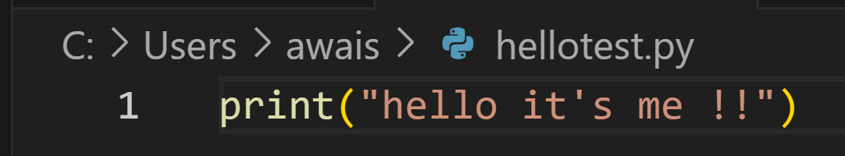
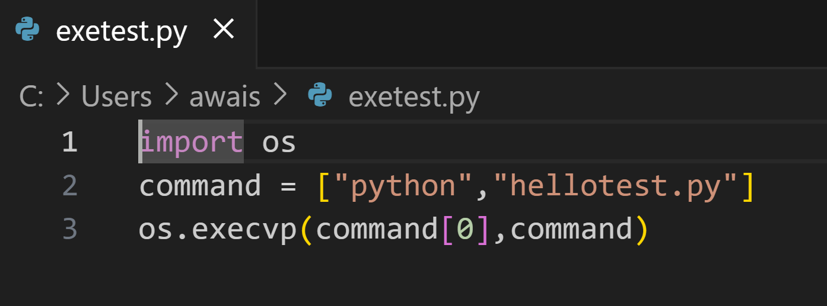

Slide 13
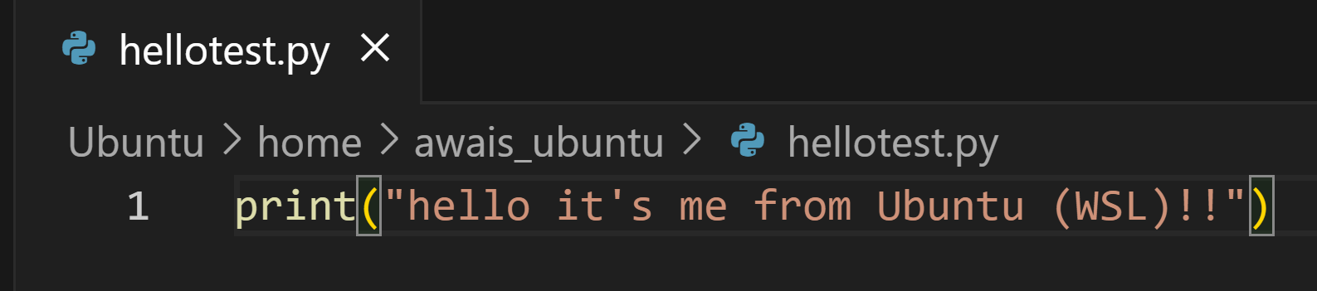
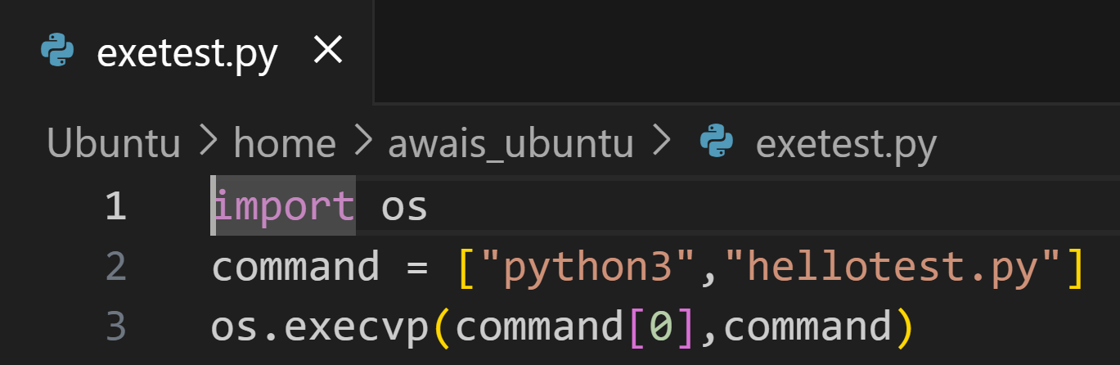

Slide 14
Did you noticed how execvp in exetest.py takes in the name of an executable file (python) as the first argument and the complete command (including the executable file’s name) as the second argument.
Running exetest.py gives us “hello it's me !!”, everything as expected!

Slide 15
Operating Systems Lab-03 –Context Switching and Process Management

Slide 16
Recap --- Processes
A program in execution, with its own memory space and system resources.
Fundamental building blocks of multitasking operating systems.
Enable execution of multiple programs simultaneously.
Each process allocates CPU time, memory, and I/O resources.

Slide 17
fork()
os.fork() -> Used to create a new process (child) from an existing one (parent).
How it works -> Duplicates the calling process's memory space.
Return Values of fork():
Returns 0 to the child process.
Returns child's PID to the parent process.
Returns -1 on failure (e.g., resource limit reached).

Slide 18
fork()
import os
pid = os.fork()
if pid == 0:
print("Child process")
else:
print("Parent process")

Slide 19
The wait() System Call
Allows a parent process to wait for its child to finish execution.
Returns the child’s PID on success or -1 on error.
pid, status = os.wait()
Example Use Cases:
Ensures proper cleanup of child processes.
Retrieves the child’s exit status.

Slide 20
The wait() System Call - wexitstatus
Macro to extract the exit status of a terminated child process
Called after wait() to decode the status.
0 for success, non-zero for failure.
import os
pid, status = os.wait()
if os.WIFEXITED(status):
exit_code = os.WEXITSTATUS(status)

Slide 21
wexitstatus
In Linux, the wexitstatus macro is used to retrieve the exit status of a child process. This macro is part of the process control mechanisms provided by the operating system to manage and monitor child processes created by a parent process.
When a child process terminates, it returns an exit status to the parent process. This exit status can be obtained using the wait() or waitpid() system calls. These calls suspend the execution of the parent process until one of its child processes changes state (e.g., terminates).

Slide 22
Zombie Processes
A process that has completed execution but remains in the process table.
Happens when the parent does not call wait().
Importance of wait(): -> Prevents zombies by cleaning up resources.
import os
pid = os.fork()
if pid == 0:
# Child process code
os._exit(0)
# Parent does not call wait()

Slide 23
import os
import time
# Fork a process
pid = os.fork()
if pid == 0: # Child process
print(f"Child Process: PID {os.getpid()}")
time.sleep(2) # Simulate work
os._exit(0) # Exit with status 0 (for safe exit)
else: # Parent process
print(f"Parent Process: PID {os.getpid()}")
child_pid, status = os.wait() # Wait for the child to finish
if os.WIFEXITED(status): # Check if child terminated normally
exit_code = os.WEXITSTATUS(status)
print(f"Child {child_pid} exited with code {exit_code}")

Slide 24
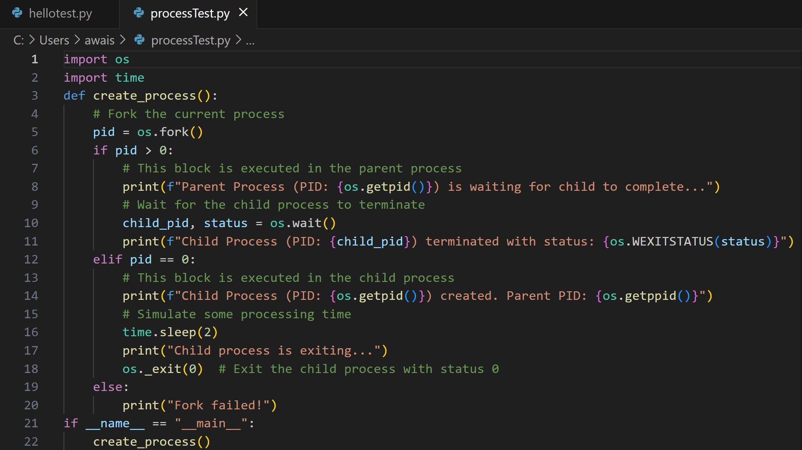

Slide 25
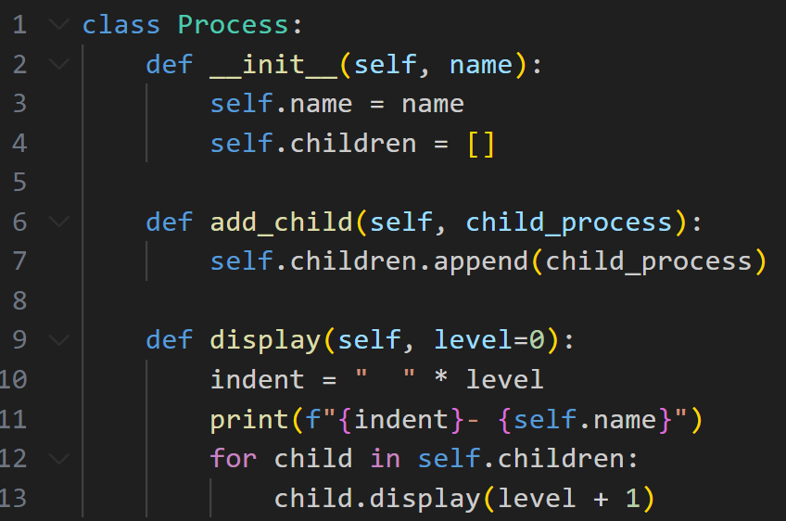

Slide 26
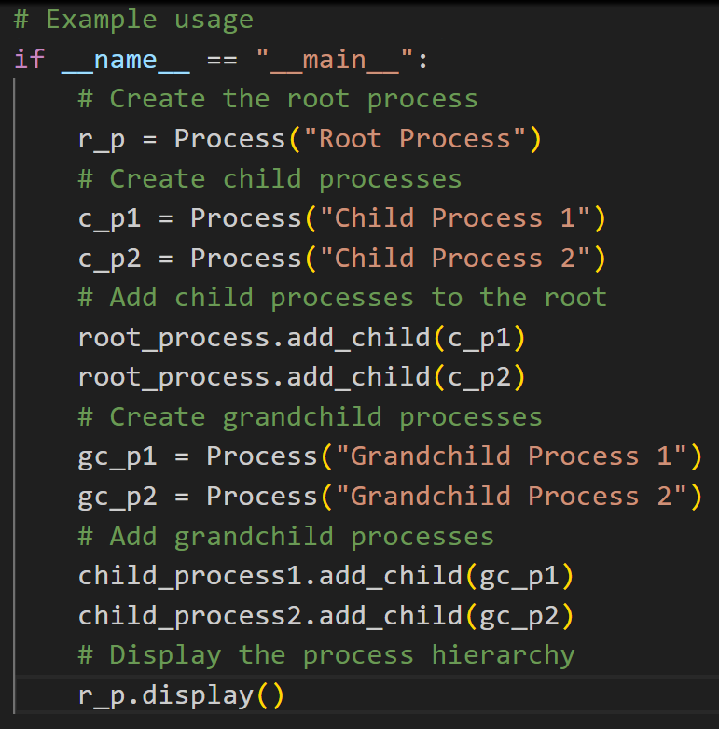

Slide 27
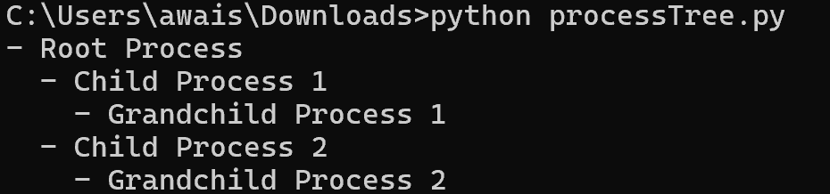

Slide 28
Bonus Question
Write a Python Script which handles Python Process creation with Parent Process and Child Processes as depicted in Image

